Slide 1


Slide 2

ABZFLOWERS
Plants • Chocolate • Gifts

Slide 3
Students:
Dany Hawari - 11830249
Jihad Ftouny - 11820033

Slide 4
Description:
Having an online shop for your local business in today’s world is essential. It can not only improve your business’ sales, but also increase its reach and your workflow as the owner. We are proposing a website for ABZ Flowers where the owner has little to no knowledge in the E-Shop domain. We will provide him with an Order System where his clients will be able to have custom orders and a cart to manage their shopping :)

Slide 5
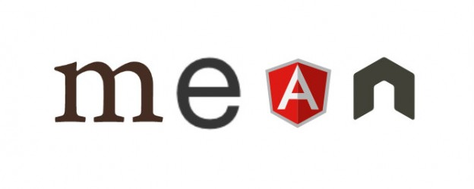
System Type:
MEAN Stack Website

Slide 6
E-Shop Functionalities:
The proposed system consists of the following panels: Admin, Shop,Events, Contact us, My Account, About us:
The landing page will be the shop tab where the customer can filter the products by categories, such as special occasions, flowers, plants, chocolates and bundles.
The Events tab will have a gallery on previous works such as weddings, funerals, baby showers, etc
In the Contact Us page, the customer will have access to a direct WhatsApp link, Google Maps location, and phone number.
In the About Us page, there will be a brief description of the shop and a welcoming message to the user, as well as the owner’s backstory in the business and a link to social media pages.

Slide 7
System Functionalities:
Admins and customers will have and email and password to log in
Admins can add or remove products, check and confirm orders, and access user’s information. They can also view statistics about sales to increase revenue for the business.
Customers and visitors can view and add products to cart, contact the shop via whatsapp or directly from Contact Us.
Customers can view their order status, add or update their information like address and password, confirm their cart order and log out.

Slide 8
Advantages:
Customer does not need to physically visit the shop to view products
Showcases the owners skill, proficiency and professionalism
Increases online reach to a wider audience through SEO
Provides the owner with insights and statistics on sales
Angular allows the page to be easily expanded upon in the future and is flexible
Single page application that allows quick loading
Avoids customers from changing last minute their order

Slide 9
Disadvantages:
No protection against spam as there is no validation/confirmation (could be fixed with email check)
No easily online payment method in Lebanon
Needs to be advertised through other means
Will need someone apart from owner to maintain

Slide 10
Technologies and Tools:
Programming language: HTML, CSS, TypeScript/JavaScript
Frameworks: Angular, Express, NodeJS, BS5
Database: MongoDB

